Slide 1
Collection Framework HashMap Vs Hashtable
momedaram

Slide 2
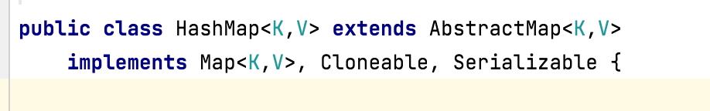
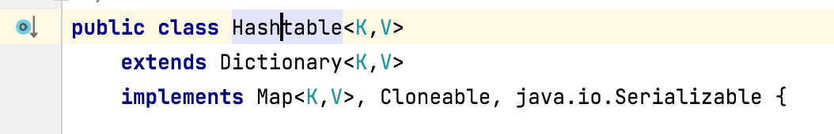
HashMap and Hashtable
Implements Map interface.
Store the data in the form of key-value pairs.
Use Hashing technique to store the key-value pairs.
Doesn’t maintain any order for elements.

Slide 3
 | HashMap | Hashtable
synchronized | No method is synchronized. | Every method is synchronized.

Slide 4
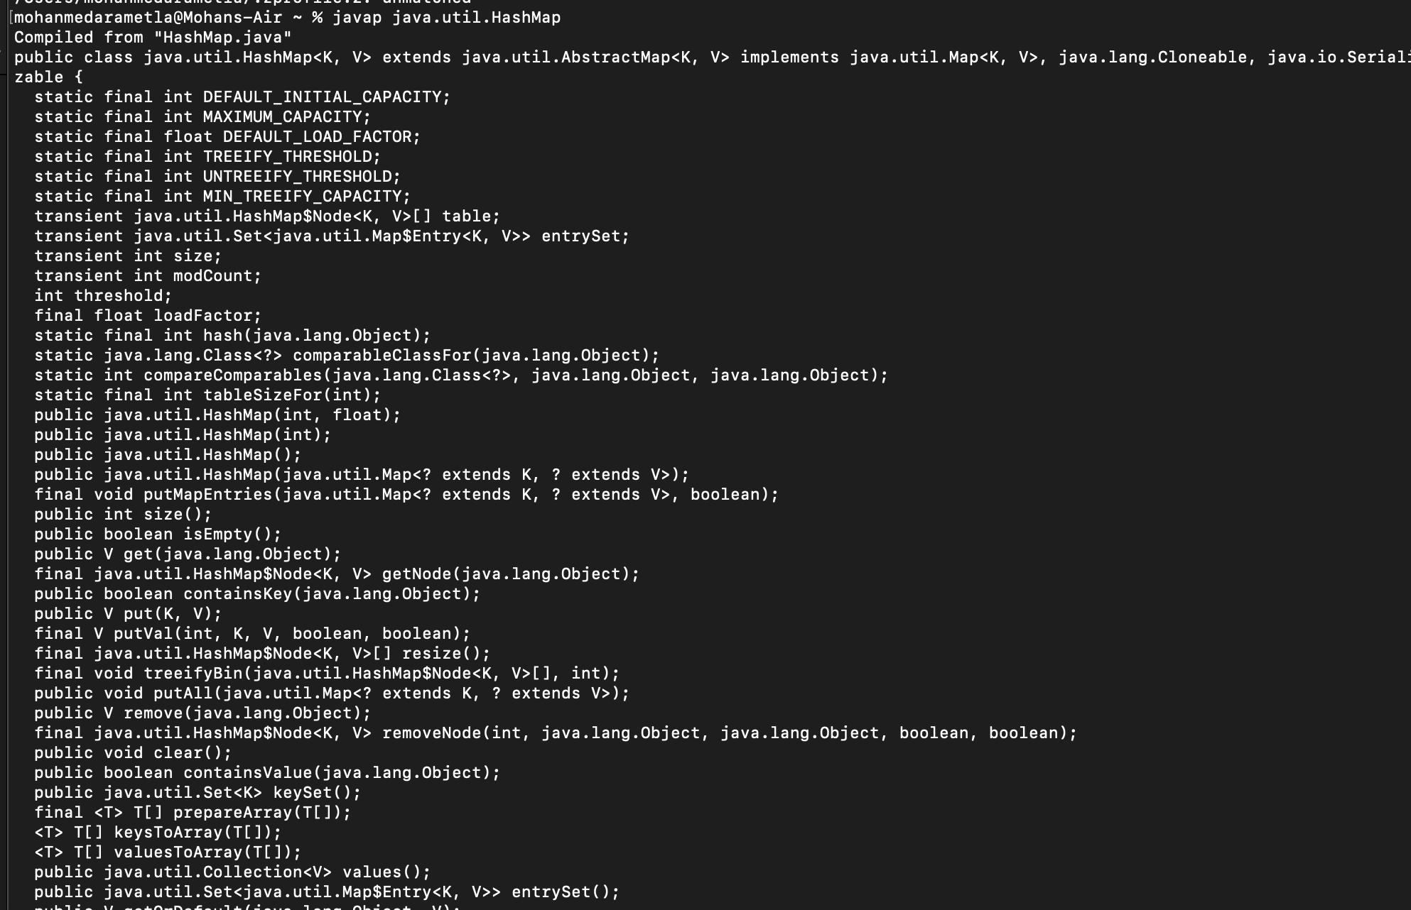

Slide 5
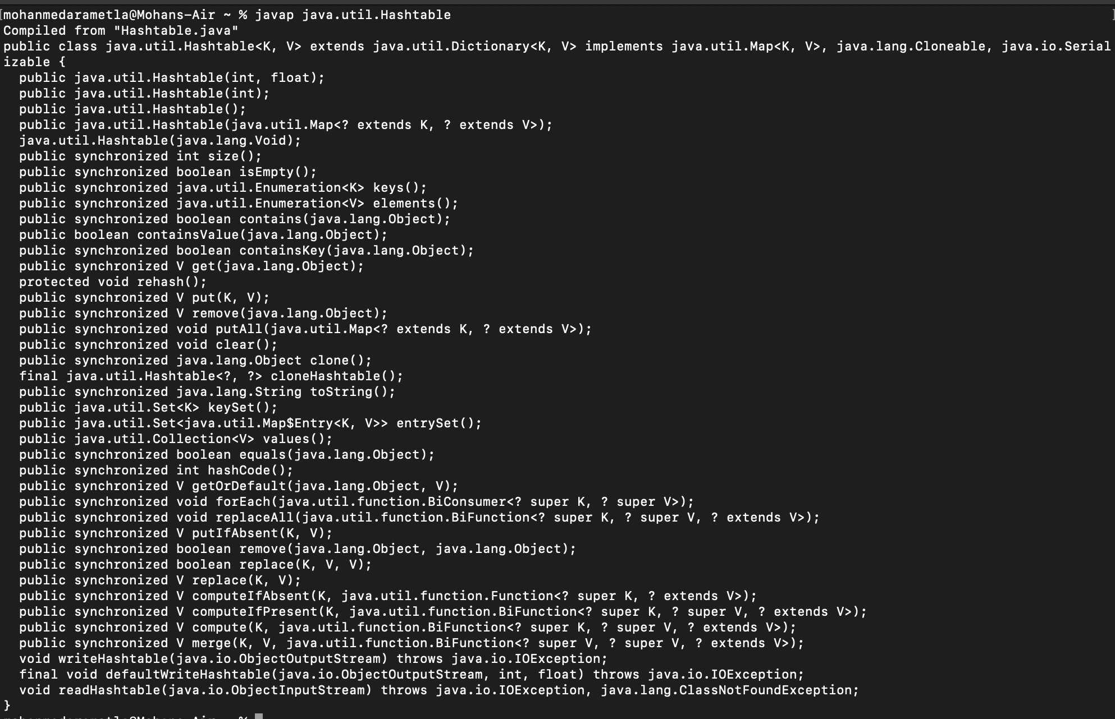

Slide 6


 | HashMap | Hashtable
synchronized | No method is synchronized. | Every method is synchronized.
Thread safe | Multiple Threads can operate simultaneously, hence it is not Thread safe. | Multiple Threads can't operate simultaneously, hence it is Thread safe.
Performance | Relatively performance is high | Relatively performance is low
Null Acceptance | Null is allowed for both key and value. | Null is not allowed for both key and value. If we add we will get NullPointerException.
Introduced | 1.2 V | 1.0 V
Traverse/iteration | Iterator | Iterator & Enumeration
Default Initial Capacity | 16 | 11
m
ht

Slide 7
Thank You !
momedaram

